Slide 1
Application of micro-XRF to characterise diamond drill-core from lithium-caesium-tantalum pegmatites
By Dr Naomi Potter
Co-author: Dr Nigel Brand
AEGC Conference 04/09/19
Notes:
Part 1: What is micro-XRF technology
Part 2: Application of micro-XRF to LCT pegmatites at the Sinclair Caesium Deposit

Slide 2
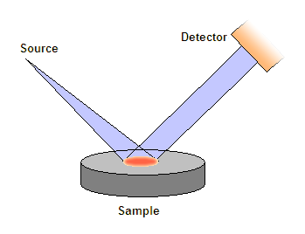
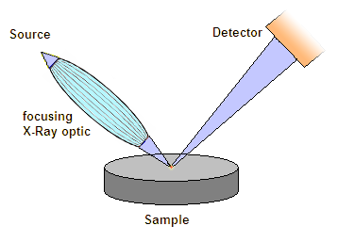
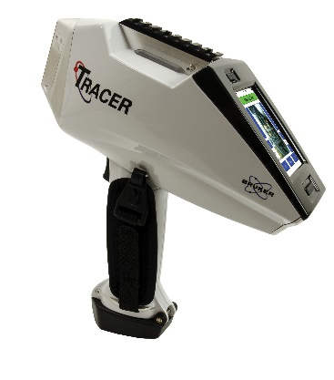
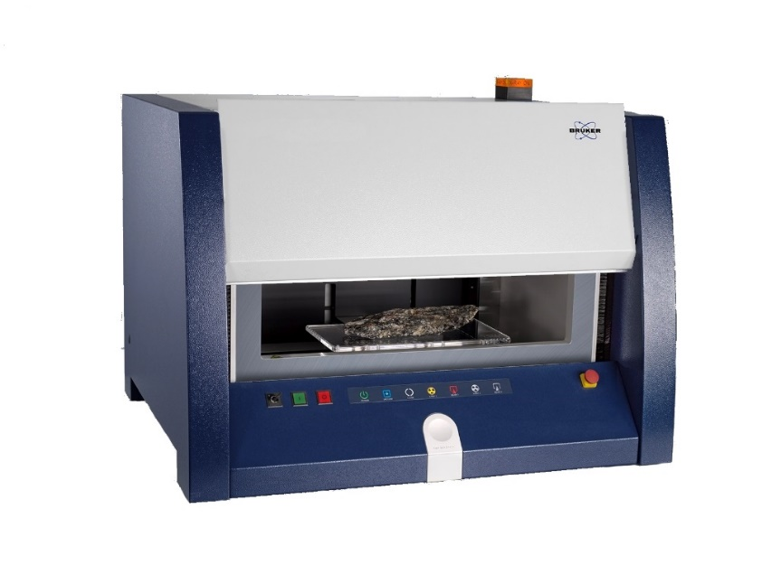
Reminder about XRF
Portable XRF
Micro-XRF
Portable spectrometer
Open beam
8 mm, 5 mm, 3 mm spot size
Samples should be homogenized*
Focus on quantification in 1D
Na¹¹ to U⁹²(TRACER)
Mg¹² to U⁹² (TITAN)
Lab spectrometer
Interlocked system
25 µm spot size
Can quantify but focused on 2D maps
Na¹¹ to U⁹² (M4)
C⁶ to U⁹² (M4 Plus)
µXRF
pXRF
X-ray Source
X-ray Source
Notes:
primary difficulties for micro-XRF has been focusing the X-ray beams - the addition of capillary optics in the micro-XRF - measure small areas without sacrificing intensity or sensitivity
Micro-XRF is a versatile tool to be utalised in the exploration and mining industry for the rapid acquisition of qualitative and quantitiative geochemical data on a variety of geological and environmental samples
a hair is 100 um thick
Said: characterise and understand the processes involved in the samples

Slide 3
Reminder about XRF
Portable XRF
Micro-XRF
Portable spectrometer
Open beam
8 mm, 5 mm, 3 mm spot size
Samples should be homogenized*
Focus on quantification in 1D
Na¹¹ to U⁹²(TRACER)
Mg¹² to U⁹² (TITAN)
Lab spectrometer
Interlocked system
25 µm spot size
Can quantify but focused on 2D maps
Na¹¹ to U⁹² (M4)
C⁶ to U⁹² (M4 Plus)
X-ray Source
X-ray Source
Notes:
primary difficulties for micro-XRF has been focusing the X-ray beams - the addition of capillary optics in the micro-XRF - measure small areas without sacrificing intensity or sensitivity
Micro-XRF is a versatile tool to be utalised in the exploration and mining industry for the rapid acquisition of qualitative and quantitiative geochemical data on a variety of geological and environmental samples
a hair is 100 um thick
Said: characterise and understand the processes involved in the samples

Slide 4
Benefits of µXRF
Qualitative and quantitative analysis
Detection limits down to ppm levels
Mapping size up to 16 x 19 cm
Versatile range of sample types
Non-destructive
No carbon coating (e.g. SEM)
Mineral maps
Minimal sample preparation required
Will change the scale and elements so they are not on their side
Courtesy of Bruker
Notes:
Sample types: drill cores, chips, ineral grains, thin section, coatings, pulp
Chamber size: 35 by 65cm
Qualitative: spatial distribution and relative abundances of major, minor and some abundant trace element elements
Quantitative: theoretical quantification method called fundamental parameterisation to determine the elemental composition.
Sample description: Rb indicates the location of the Li in the lepidolite - visually unrecognisable feature includes Ca-Sr-concentrated veins that cut amblygonite which are likely to indicate the commencement of the weathering of amblygonite by
penetrating ground waters.

Slide 5
Element compositional maps
Full X-ray spectrum for each pixel
“On-the-fly” measurements
Quantitative and qualitative
Element distribution and relationships
Alteration and weathering textures
Fluid pathways
Ca
Si
Carbonates vs. silicates
Ca
Mg
Dolomite
+
=
1 cm
Mo
Ni
V
Zn
Some trace metals with an affinity for clays?
Courtesy of Bruker
Notes:
On the fly – table doesn’t stop reducing the total time needed for analysis completion. Providing a qualitative overview of the element distribution - for quant a longer measurement time is needed.

Slide 6
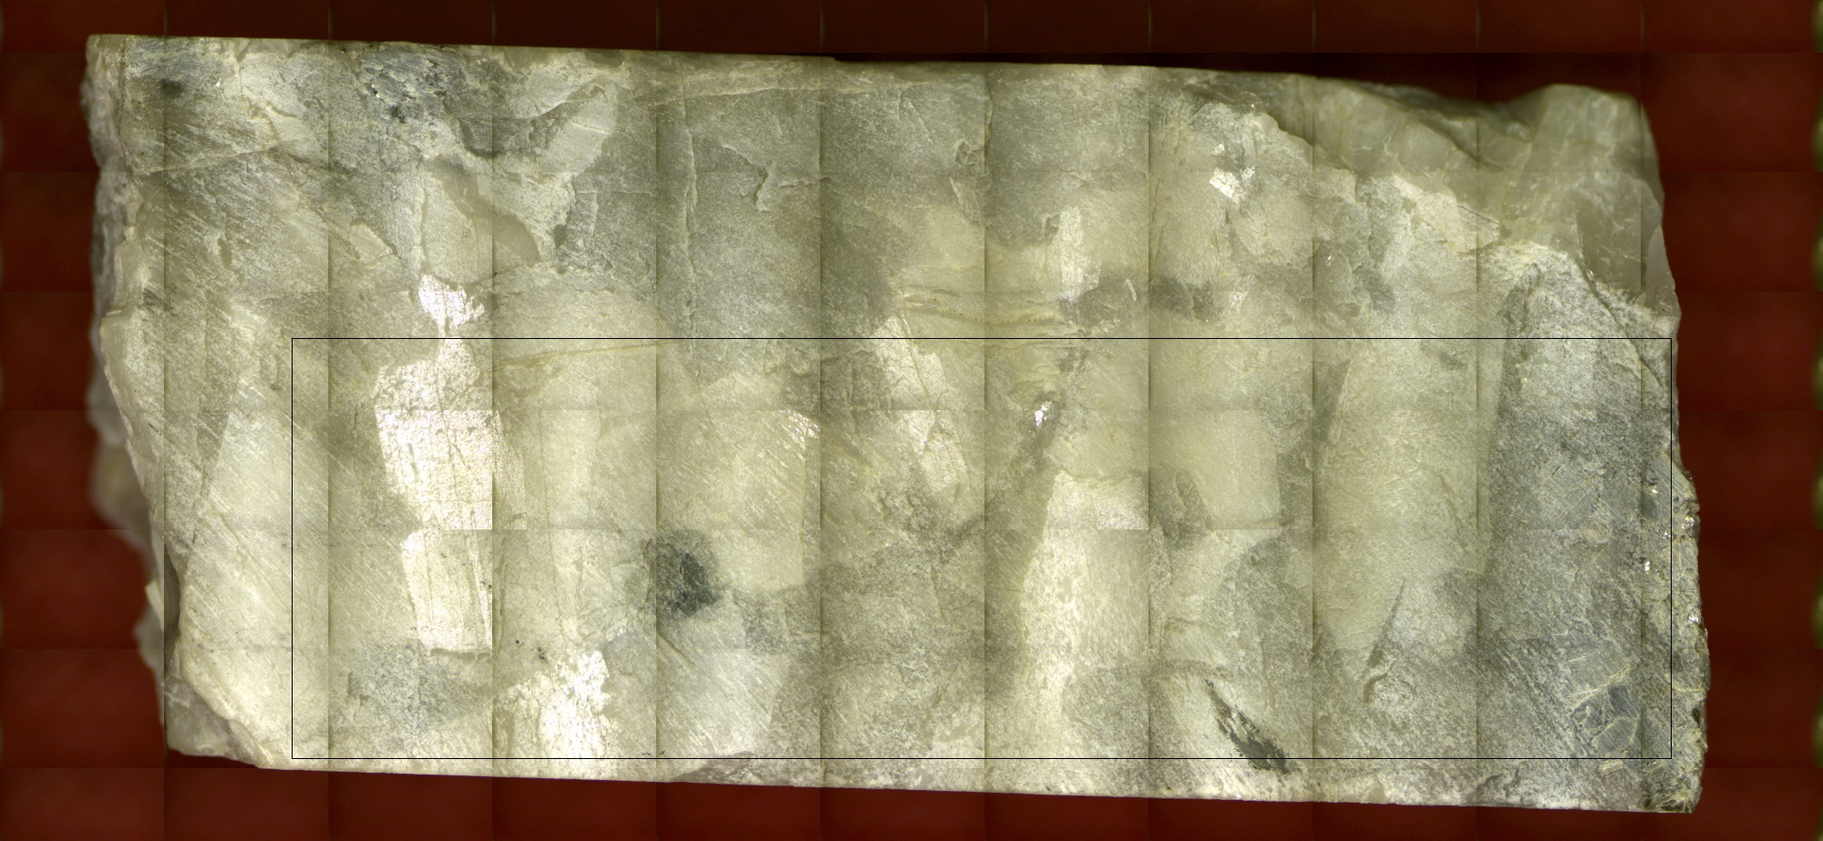
Mineral mapping
Digital images and surface profiles
Mineral identification, abundance and texture
Particle and grain size distributions
Spodumene
Illite
Jadite
Apatite
Quartz
2 cm
Notes:
Stitched together image – not a photo.
Metallurgical applications – what minerals are there, their abundance and their association with each other on a fine scale.
Sample: LCT pegmatite sample – spodumene rich with quartz
Spodumene is the mineral of interest and as sophie mentioned earlier by visual identication it is difficult to differentiate spodumene and quartz textures - the raman enables us to do that (see which part is which), but what if you want to determine the textural relationship between the two?
Five minerals were identified, with spodumene as the dominant phase (~57%). Furthermore, illite, apatite and jadite may have been unidentified or misidentified by visual inspection alone.
Not only identify the texture but also the composition and abundance

Slide 7
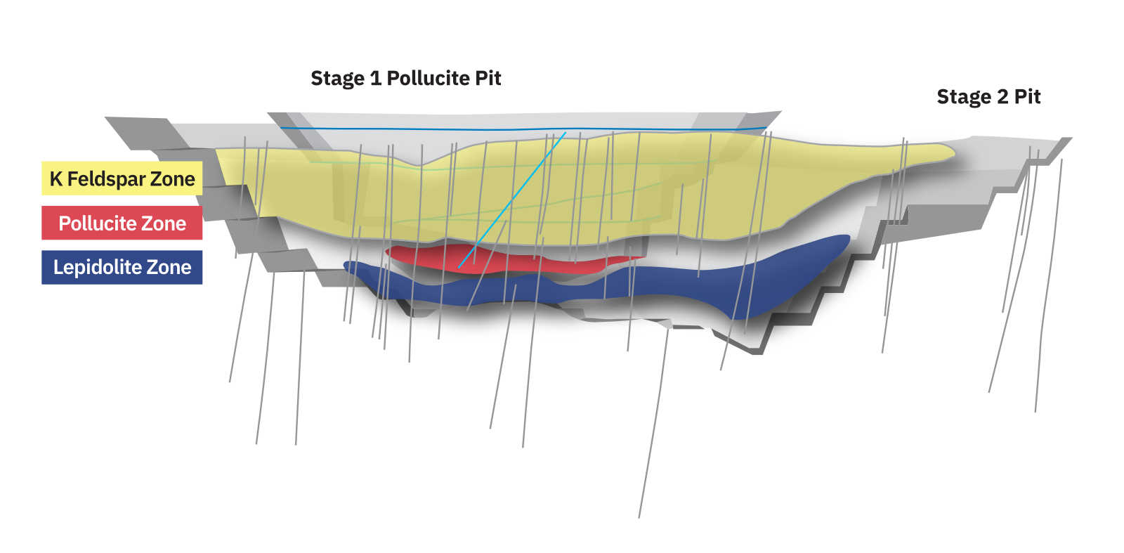
Sinclair Caesium Deposit

Slide 8
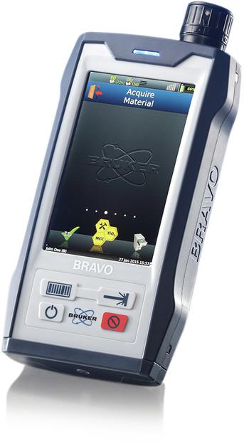
Workflow
Portable XRF
Collect Core Samples
Micro-XRF Selective Scanning
Raman
Notes:
Once you have collected the samples - Semi-quantitative chemistry and mineralogy.
Mineral chemistry and micro-textures to answer specific questions.
Maps show can give thin-section quality data fast, in hours not weeks.

Slide 9
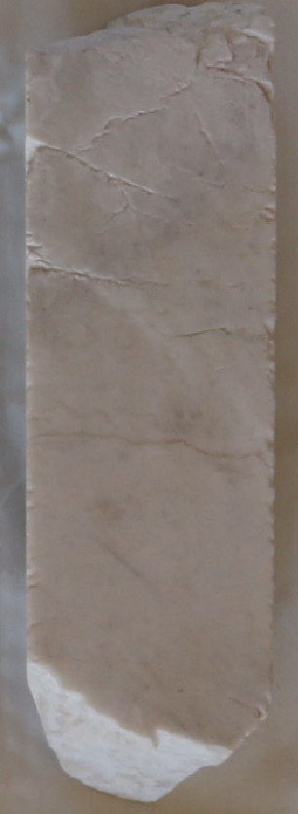
Microcline
Scale – need!
Notes:
Within the microcline zone of the deposit, high Fe contents were identified in the samples. So needed to check if the iron was due to contamination from the sample preparation and drilling or associated with the mineralogy of the rock (part of the rock sequence).

Slide 10
K
Spot pXRF K2O: 9.67wt%
Notes:
Homogeneous distribution of K

Slide 11
Na
pXRF n/a
Notes:
Start seeing the perthite on a microsclae – not visible in the hand specimen

Slide 12
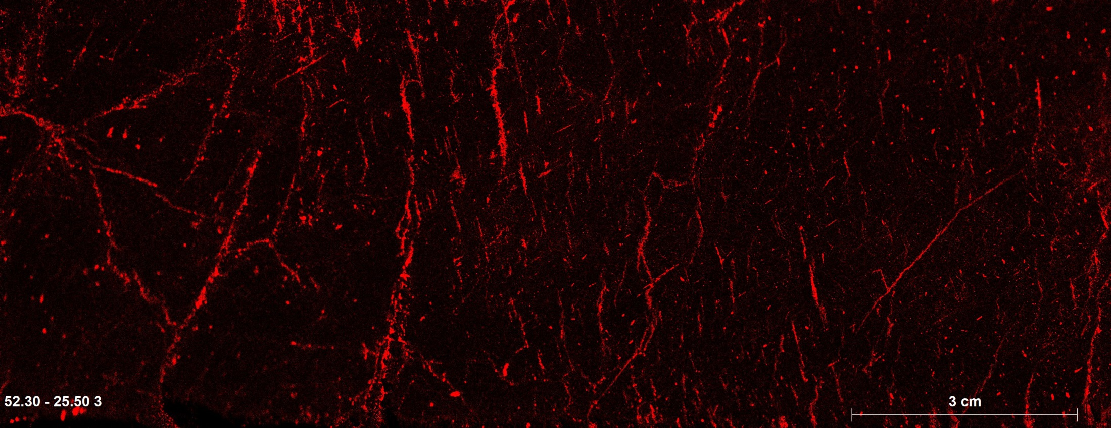
Fe
Spot pXRF Fe: 7040 ppm
Notes:
Not distributed homogeneously throughout the microcline, as you would expect if it was part of the mineralogy. Instead it is associated with the cracks in the rock sample.
These images show that the Fe is associated with alteration through the fractures in the rock ,and the alteration of microcline to sericite.
Cannot see in the hand specimen the smaller cracks – uXRF penetrates into the sample so may be seeing cracks below the surface
The overall concencus is that the microcline is altering to sericite (illite has Fe) producing the higher Fe contents and is not due to contamination from the sampling method
good quality mirocline with some green sericite coating fractures and rare green muscovite rare black specs of manganese

Slide 13
Notes:
Not distributed homogeneously throughout the microcline, as you would expect if it was part of the mineralogy. Instead it is associated with the cracks in the rock sample.
These images show that the Fe is associated with alteration through the fractures in the rock ,and the alteration of microcline to sericite.
Cannot see in the hand specimen the smaller cracks – uXRF penetrates into the sample so may be seeing cracks below the surface
The overall concencus is that the microcline is altering to sericite (illite has Fe) producing the higher Fe contents and is not due to contamination from the sampling method
good quality mirocline with some green sericite coating fractures and rare green muscovite rare black specs of manganese

Slide 14
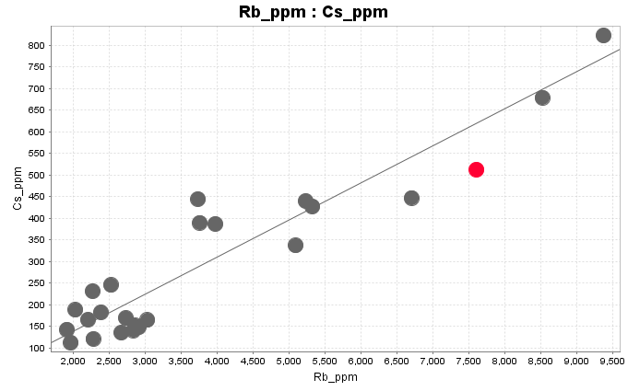
Next question…
Notes:
At the deposit, the core is being scanned per meter, which means for every 1m of core you have 1 analysis point to summaries that section.
And within this deposit there is a strong correlation between Cs and Rb. But what is the relationship between Cs and Rb
There is a correlation on a m by m scale but what about the microscale?
Lower microcline – just above pollucite ore – red dot is sample we are looking at.

Slide 15
Microcline
18 cm
Notes:
Another piece of microcline from deeper within the deposit was scanned to answer another question.
white chalky feldspar (albite? – in ppt) breaking down to clay with green sericite very broken zone
ASD: phengitic illite
Albite: NaAlSi₃O₈.

Slide 16
K
Notes:
Homogeneously distributed, but there is a clear texture here with sections of the microcline being K poor
grain of potassium-rich alkali feldspar includes exsolved lamellae or irregular intergrowths of sodic alkali feldspar.
perthite is an intimate intergrowth of sodic and potassic feldspar resulting from subsolidus exsolution (unmixing of two minerals).

Slide 17
Na
Notes:
However, Na shows the opposite relationship. This indicates a perthitic (interstitial) texture within the microcline, with albite forming irregular intergrowths - which is the subsolidus exsolution we were able to notice in the hand specimen
the dissolution between the different element phases….
grain of potassium-rich alkali feldspar includes exsolved lamellae or irregular intergrowths of sodic alkali feldspar.
perthite is an intimate intergrowth of sodic and potassic feldspar resulting from subsolidus exsolution (unmixing of two minerals).

Slide 18
Rb
Notes:
Rb also shows a similar distribution
‘gradual reduction’

Slide 19
Mn
Notes:
Mn not replicating the rock texture and appears to be unevenly distributed, with no particular orientation

Slide 20
Cs
Notes:
Cs not replicating the rock texture and appears show two band moving through the sample distributed - alteration front?
Essentially there is a correlation on a meter by meter scale but at a microscale they are not associated together

Slide 21
Cs - Na
Notes:
Essentially there is a correlation on a meter by meter scale but at a microscale they are not associated together
Spatially associated not mineralogically associated.

Slide 22
Pollucite
17.5 cm
Notes:
The goal was to identify the composition of the veins running through the pollucite. The raman had identified some feldspar but could not delineate between the vein and the surrounding sample (get to Soph to confirm this). - feldspar grians/veins and lepidolite veins
high grade pollucite zone with lepidolite veinlet texture rimmed by blue cleav greasy lustre appearance >20% Cs Bruker pXRF
Quenching cracks? Mineralogical or alteration, discoulouration

Slide 23
Cs
Notes:
Caesium showing the presence of pollucite
Caesium pervasive through put the sample of pollucite
Low concentrations in the lepidolite veinlets and “albite”
NOTE elevated Cs in the Fe veins (1)
Darker section is not associated with a decrease in Cs.

Slide 24
Rb
Notes:
Elevated concentrations of rubidium mapping out veins of lepidolite and the abundance of Rb varies within the veins
Also elevated at the rim of the core.
Lepidolite veins typically trending
NE
NNW
set of “wispy veinlets trending NNE

Slide 25
Mn
Notes:
Manganese elevated in
lepidolite veinlets NE and NW –
NW clearer in Manganese
Lepidolite veins typically trending
NE
NNW
set of “wispy veinlets trending NNE

Slide 26
Na
Notes:
anhedral albite grains (thus interpreting phase as albite)
Accumulations within the NNW trending lepidolite veinlets with a similar orientation
Solid solution series between pollucite and Na rich endmemeber

Slide 27
K
Notes:
Potassium elevated in
lepidolite veinlets plus additional veins mapped out by K
Unknown phase that not associated with albite
Low level potassic alteration around the anhedral albite grains, forming a ghosting halo

Slide 28
Sr
Notes:
Strontium elevated in
lepidolite veinlets (weak)
Unknown phase (weak)
anhedral albite (strong) with apparent zonation
Albite association with the lepidolite veins – feeding into the veins.

Slide 29
Ca
Notes:
Calcium elevated in the
anhedral albite grains
Disseminated through out the “albite regions

Slide 30
Ca-Sr-Rb
Notes:
Rubidium mapping out lepidolite views
Strontium mapping out anhedral albite
Calcium mapping out “albite” pseudomorphs
So the uXRF analysis was done to identify the composition of the veins and instead it shows that there are actually multiple veining events occurring through the sample. The feldspar (albite) grains were identified and they are now anhedral and have pervasive alteration halos. Cs is not chemically zoned at all throughout the pollucite but there is alteration and zoning in the other elements occurring throughout the sample
So a wealth of information and knowledge was gained from a quick scan of pollucite ore.

Slide 31
Notes:
Rubidium mapping out lepidolite views
Strontium mapping out anhedral albite
Calcium mapping out “albite” pseudomorphs
So the uXRF analysis was done to identify the composition of the veins and instead it shows that there are actually multiple veining events occurring through the sample. The feldspar (albite) grains were identified and they are now anhedral and have pervasive alteration halos. Cs is not chemically zoned at all throughout the pollucite but there is alteration and zoning in the other elements occurring throughout the sample
So a wealth of information and knowledge was gained from a quick scan of pollucite ore.

Slide 32
Summary
Rapid, non-destructive technique
Versatile sample types and sizes
Acquire qualitative and quantitative data at high spatial resolution
Element distribution and mineral maps
Suited for rapid studies to investigate the micromorphology, chemical variability and mineral alteration in samples
Courtesy of Bruker
Notes:
The ability to identify these mineralogical, textural and chemical features after a few hours of scanning with no sample preparation required highlights the benefits of this new technology.
To date this technology has not yet been utilised to its full potential in the exploration, mining and metallurgical industries. So a quick presentation to show you what information can be collected after a few hours of scanning.
Micro-XRF is a versatile tool to be utalised in the exploration and mining industry for the rapid acquisition of qualitative and quantitiative geochemical data on a variety of geological and environmental samples
Micro X-ray fluorescence (µXRF) is a rapid and non-destructive technique used to acquire qualitative and quantitative data at high spatial resolution (i.e. µm scale).
Micro-XRF instrumentation can acquire a wealth of geochemical, mineralogical and petrological information for a versatile range of sample types and sizes, due to the large sample chamber and small X-ray beam size. The non-destructive nature of the instrument combined with the minimal sample preparation required is a major advantage over other geochemical techniques and makes µXRF ideally suited for rapid and inexpensive studies aimed at investigating micromorphology, chemical variability and mineral alteration in rock samples.

Slide 33
Acknowledgements
For more information visit: https://www.portaspecs.com/product/m4/

